Slide 1

Images
Weekly Summary
16. December
2015
Color Model
Compression
image-tag
http://www.creativebloq.com/design/designers-guide-image-compression-10121068

Slide 2




Images
Color Model
Compression
Vector
Bitmap
image-tag
©Joshua Töpfer

Slide 3
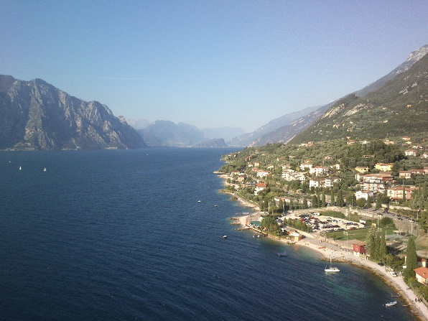
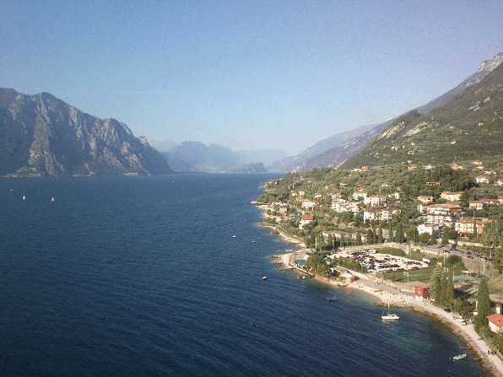


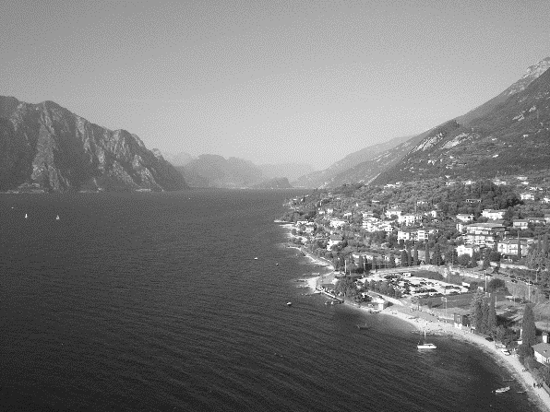
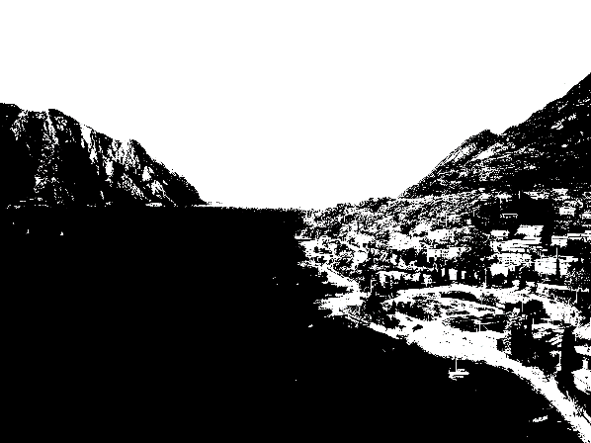
Images
Bitmap
Color Model
8-Bit
8-Bit
Compression
8-Bit
8-Bit
image-tag
8-Bit
1-Bit

Slide 4
Images
Color Model
PNG
JPG
GIF
lossless?
Transperency?
Colors?
Animations?
Compression
16.7 mio
(24-bit)
16.7 mio
(24-Bit)
256
(8-bit)
PS
SVG
image-tag
vector images + text
Developed by Adobe
XML-Based

Slide 5
Color Model
Compression
RGB
additive
device independent
image-tag
CYMK
substractiv •

Slide 6
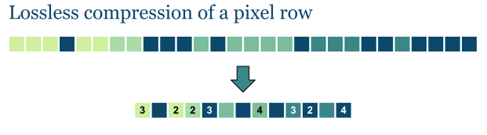
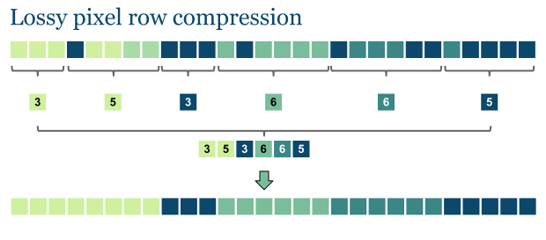
Compression
iImage-tag
http://www.stoimen.com/blog/2012/05/03/computer-algorithms-lossy-image-compression-with-run-length-encoding/

Slide 7
Images in html
Image-Tag
<img src="path to image" alt="text" width="200" height="200"/>
Image-Maps
<img name="img_map" src="img_map.jpg" usemap="#m_img_map"/>
<map name="m_img_map" id="m_img_map">
<area shape="rect" coords=
"226,8,392,188" href="r.html"
/>
</map>

